Slide 1

Exploratory Data Analysis on AMCAT Dataset

Slide 2
Description:
The dataset, sourced from the Aspiring Mind Employment Outcome 2015 study, focuses on employment outcomes of engineering graduates. It includes variables like salary, job titles, and locations, alongside standardized scores in cognitive, technical, and personality skills, and demographic features. With around 4000 data points, it provides insights into the factors influencing graduates' professional paths.
Objective:
Analyze the target variable 'salary' and find insights from it.

Slide 3
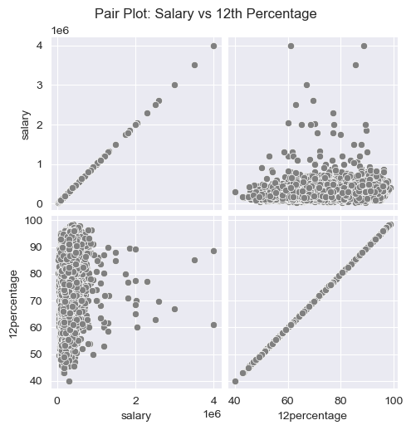
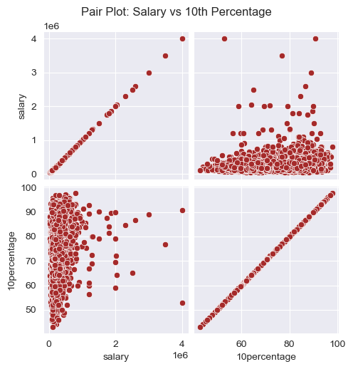
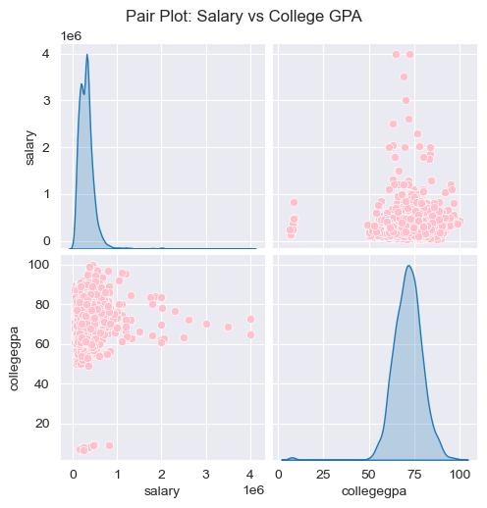
Insights :
There is no relationship between students marks and their salaries

Slide 4
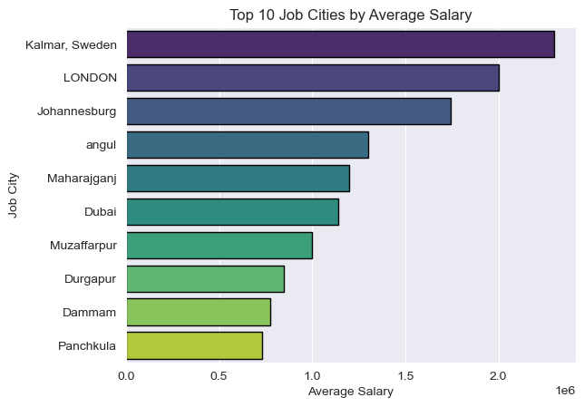
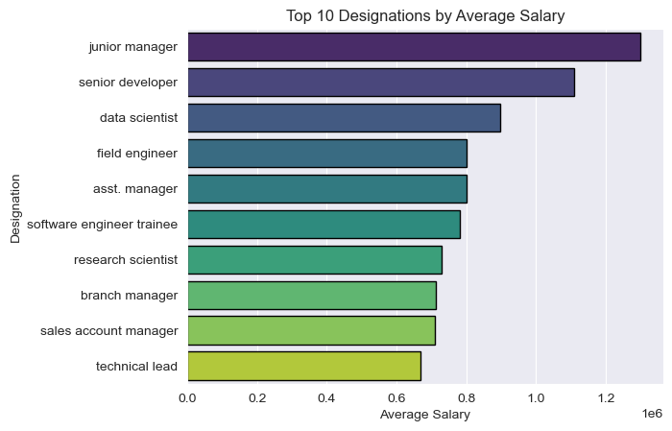
Students work in Kalmar,Sweden has earn more salary
Students in junior manager and senior devloper role earn more salary

Slide 5
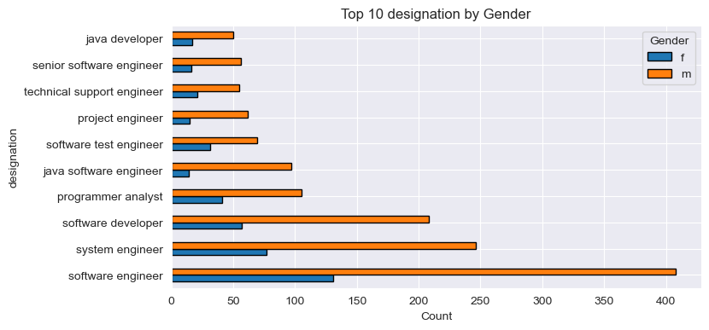
Almost males 2 times as of females in every designation.But female preferred software engineer

Slide 6
Conclusion :
There is no relationship between students marks and their salaries
Almost males 2 times as of females in every designation.But female preferred software engineer
Students work in Kalmar,Sweden has earn more salary
Students in junior manager and senior devloper role earn more salary

Slide 7


